Slide 1
Qt Quick Application Implement UI with QML
V1.0

Slide 2
Now we will start in
What is QML ?
How can we work with QML ?
QML Basic Controls
QML Custom Controls

Slide 3
What is QML ?
QML is a language which can be used to:
Create UI by defining Components
Define interaction & relationship between components
(Optional) Connect to back-end C++ libraries

Slide 4

How can we work with QML ?
We can work by QML code or by design tool (in Qt Creator)
Guideline for definitions, syntax, convention, glossary: http://doc.qt.io/qt-5/qmlapplications.html
Child controls component will handle event
QML define Components as layers
(4) Child Controls
(3) Controls
(2) Screen
(1) Application Window
Controls component will handle event
(4)
Screen Component will handle event
(3)
Application Window will handle event
(2)
(1)

Slide 5
How can we work with QML ? (Cont)
For example: create an application which has a button with icon on screen
In main.qml
ApplicationWindow{
id: mainWindow
…
MouseArea{
id: buttonArea
onclicked:{showMessage(“button is clicked”)}
MouseArea{
id: iconArea
onclicked:{showMessage(“icon is clicked”)}
MouseArea{
id: XArea
onclicked:{deleteIcon()}
}
}
}
}
Button name
icon
X
(4)
(3)
(2)
(1)

Slide 6
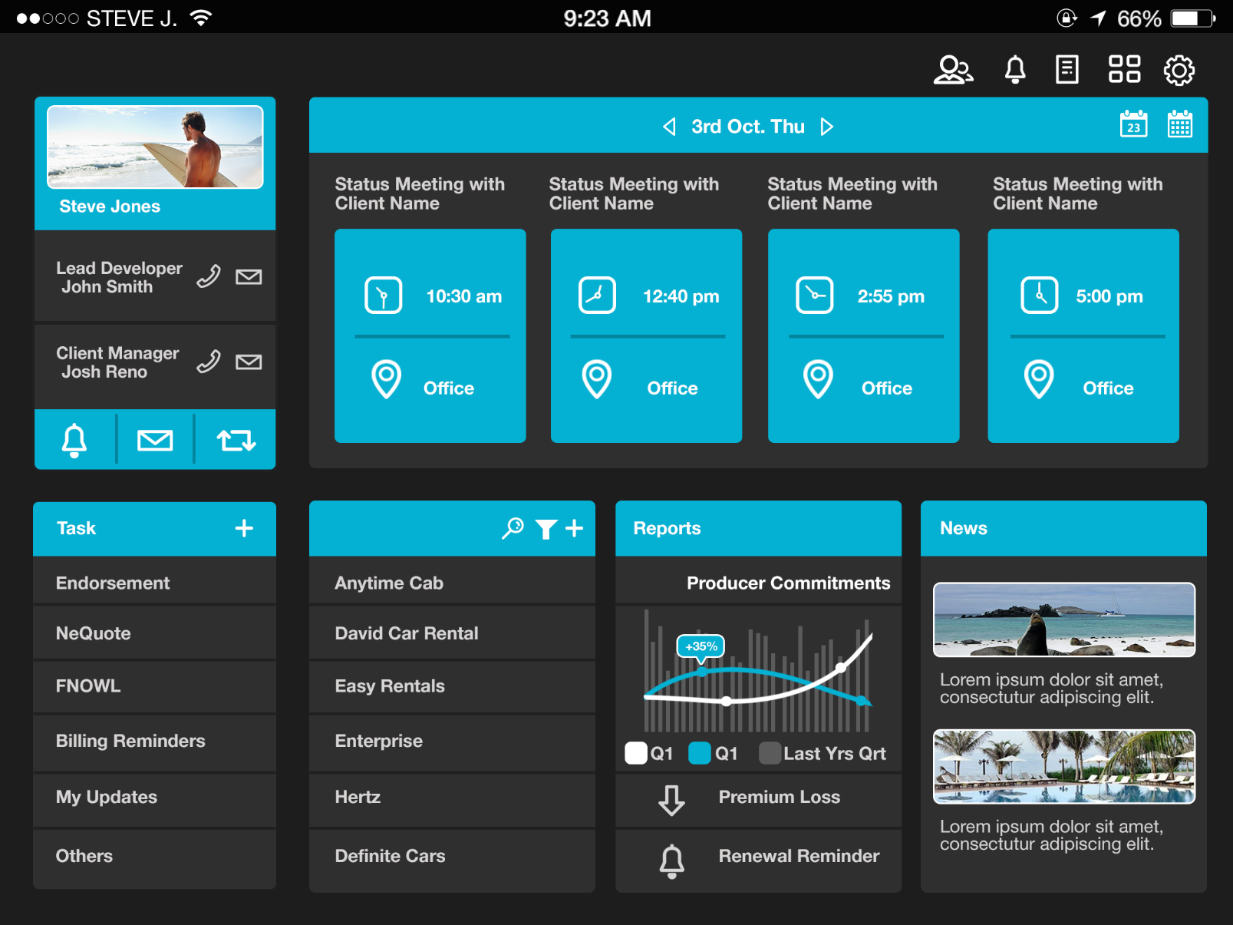
How can we work with QML ? (Example)

Slide 7
QML Basic Controls
There are some basic controls that we should know when start with QML:
Rectangle: display an area of controls
MouseArea: area that will handle mouse event (or touch event)
Listview: display items on list by horizontal or vertical
ApplicationWindow: define an main window application
Note: There are many samples about usage of other controls in QML. Please refer in Qt Creator (Welcome -> Examples) or Qt documents (http://doc.qt.io/)

Slide 8
QML Basic Controls
Rectangle: is the most basic control.
It define an rectangle on screen. Everything can be created by Rectangle
Usage: create button, sub screen, textbox, dialog box, line, round, triangle, etc.
Rectangle
(Anything can be added here)

Slide 9
QML Basic Controls (Rectangle)
There are some properties of Rectangle component that we usually use:
Width / Height (MUST): rectangle is only valid to display when it has defined width & height.
Color: filled color of rectangle. It can be 1 color, transparent or gradient color. (default is White)
Radius: value apply for rounded corner of rectangle
Clip: clip child components if it display outside of rectangle (default is false)
Rotation: rotate specific angle

Slide 10
QML Basic Controls
MouseArea: define an area that will interact with mouse event.For example: Button = Rectangle (draw button UI) + MouseArea (handle button Event)
Sample Button
Click here
MouseArea component
Rectangle component

Slide 11
QML Basic Controls (Mouse Area)
There are some properties of Mouse Area component that we usually use:
Width / Height (MUST): Mouse area is only valid to display when it has defined width & height.
hoverEnabled: enable / disable hover for mouse area
acceptedButtons: define button (left / right) that will be accepted in mouse area
Entered: mouse is entered mouse area
Exited: mouse is exited from mouse area
Pressed: mouse is pressed in mouse area
MouseX/Y: x, y position of mouse inside mouse area

Slide 12
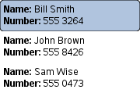
QML Basic Controls
ListView: define a list of component (model). Listview can display with horizontal & vertical alignment. There are also some controls that display list of items: repeater, gridview.
delegate: stand for an item of ListView. It is usually used to customize item of Listview
model: data of ListView. It can be list of object (ListModel), stringlist or list of C++ class (defined with Q_OBJECT macro)
Listview
delegate
Model
name: "Bill Smith" number: "555 3264“
name: "John Brown" number: "555 8426“
name: "Sam Wise" number: "555 0473"

Slide 13
QML Basic Controls (ListView)
There are some properties of ListView component that we usually use:
Width / Height (MUST): Listview is only valid to display when it has defined width & height
Clip: child components can display outside of rectangle or not
Delegate: define a template for item of list
Model: data of list
Interactive: decide list is scrollable or not
Count: number of displaying item in list
Orientation: orientation of list (horizontal or vertical list)
Spacing: space between items

Slide 14
QML Custom Controls
QML Controls ,which was created by Qt, are all editable. We can customize by using component directly inside controls.
For example
Sample button with icon
icon
Icon component
Default button component
Button{
id: btnSample
Image:{
source:”sampleIcon.png”
x:0
height:parent.height
width: height
}
}

Slide 15
QML Custom Controls
For using QML Custom Controls in other .qml files:
Define.qml file which represents for a custom control. Each .qml file is also an class which has property, signal, function. It also inherit property, signal, function of its top-level component.
In order to use QML Custom Controls, all .qml file must be in the same folder. If it is in different folder, we must use “import /…” command to import QML class.
In CustomButton.qml
Rectangle{
id: recButton
CustomButtonText{
textColor: “blue”
text:”custom button”
}
}
In CustomButtonText.qml
Text{
id: txtButton
property color textColor: “red” //default
text:”custom button”
}
Inherit custom property
Inherit exising property

Slide 16
QML Custom Controls
There are some features of custom controls that we usually use:
property: define properties of control that can be use externally / internally. This can be defined as read-only property.
function: define function of control
signal: define signal (event) of control. Note: event name = “on” + Signalname (uppercase first character)
For example: signal name = signalTest => event name = onSignalTest

Slide 17
Q & A

Slide 18
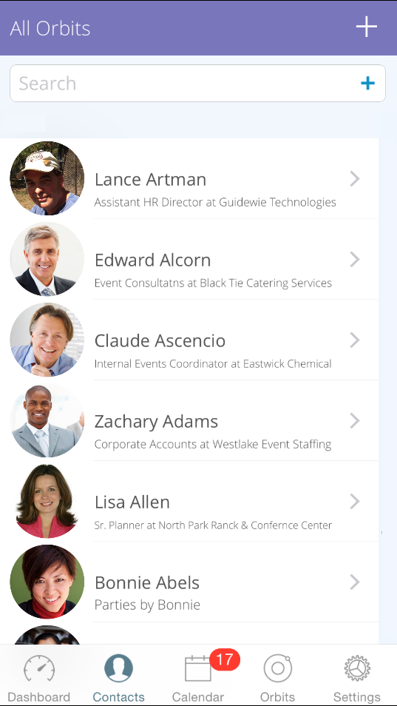
Exercise
Sample A: Create application as list of contact
Target:
Implement “Contacts” screen only
Let other screen empty
Suggestion: using components as below
ListView
Rectangle
MouseArea
SwipeView (Optional)
Image
Etc… ☺ (self-define)

Slide 19
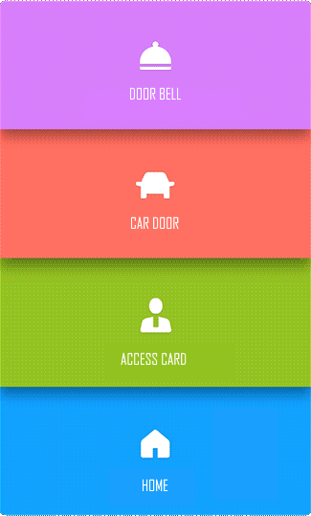
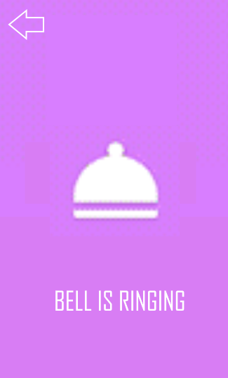

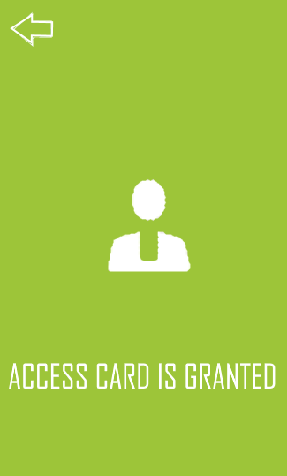
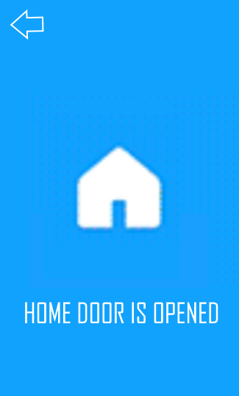
Exercise
Sample B: Create application as list of location
Target: Implement location list & connection screens
Suggestion: using components as below
ListView
Rectangle
MouseArea
StackView (Optional)
Image
Etc… ☺ (self-define)

